Slide 1
Project : 10 Bit Processor
Course : Cse-332
Group Members :
1. Kh. Sadik 1621536042
2. Milon Hossain 1610497042
3. Fahad Ahmed Pranto 1612607042
4. Durjoy Nag Prattay 1620243042

Slide 2
Objectives: Our objectives was to design a 10 Bit ISA which can solve a particular problems i. e. Simple arithmetic & logic operations, branching and loops.
Operands: Our goal is to use accumulator base ISA. For this reason we are going to take two operands.
Types of Operands: To implement arithmetic instruction we need register operands and for data transfer instruction from memory to register we need memory operands. So we need two types of operands.
1. Register Based.
2. Memory Based.

Slide 3
Operations: We will allocate 4 bits opcode, so the executable instructions number will be 2⁴ or 16.
Types of operations: In our design there will be five different types of operation. The operations are:
Arithmetic
Logical
Data Transfer
Conditional Branch
Unconditional Jump

Slide 4
Category | Operation | Name | Type | Opcode | Syntax | Comments
Arithmetic | Add two numbers | add | R | 0000 | add, $s1,$s2 | $s1 = $s1 + $s2
Arithmetic | Add number with an immediate | addi | I | 0001 | addi $s1, 5 | $s1 = $s1 + 5
Arithmetic | subtraction | sub | R | 0010 | sub $s1, $s2 | $s1 = $s1 - $s2
Logical | Shift left | sll | I | 0011 | sll $s1, 2 | $s1=$sp<<2
Logical | Bit –by-bit and | And | R | 0100 | And $s1 , $s2 | $s1=$s1 & $s2
Logical | Bit –by-bit nand | Nand | R | 0101 | Nand $s1,$s2 | $s1 = $s1 Nand $s2
Data transfer | Load word | lw | I | 0110 | lw $s3, 16 | $s3=Mem[$sp+16]
Data Transfer | Store word | sw | I | 0111 | sw $s3,16 | Mem[$sp+16]=$s3
Data Transfer | Display | dsp | I | 1000 | dsp | Display the value of $out
Data Transfer | Input | inp | I | 1001 | inp $s3 | $in will get a data and pass it to $s3
Data Transfer | Output | otp | I | 1010 | otp $s2 | Load $out with $s2 and show
Conditional | Check equality | beq | I | 1011 | Beq $s3,7 | If($s3==$sp) then 7
Conditional | Compare less than | slt | R | 1100 | slt $s1,$s2 | If($s1<$s2)then $sp=1 else $sp=0
Unconditional | Jump | jmp | I | 1101 | jmp 12 | Go to line 12

Slide 5
Formats:
We would like to use two types of formats for our ISA. They are:
Register Type – R type
Immediate Type – I type
R Type ISA Format:
Opcode | rd | rs
4 bits | 3 bits | 3 bits

Slide 6
I Type ISA Format:
Opcode | rd | Immediate
4 bits | 3 bits | 3 bits
List of Register:
Register Number | Conventional Name | Usage | Binary value
1 | $s0 | Storing Value | 0000
2 | $s1 | General Purpose | 0001
3 | $s2 | General Purpose | 0010
4 | $s3 | General Purpose | 0011
5 | $s4 | General Purpose | 0100
6 | $s5 | General Purpose | 0101
7 | $s6 | General Purpose | 0110
8 | $s7 | General Purpose | 0111

Slide 7
Translating Some HLL codes using our Designed 10 Bit ISA
1. a = a + b #$s1 = a, $s2 = b
add $s1, $s2 # $s1 gets $s1 + s2
2. a = a – b #$s1 = a, $s2 = b
sub $s1, $s2 # $s1 gets $s1 – s2
3. a = a AND b #$s1 = a, $s2 = b
And $s1, $s2 # $s1 gets $s1 && $s2
4. a = Not(a) #$s1 = a
Nand $s1, $s1 # $s1 gets inverted value of $s1

Slide 8
5. C = A[i] #$s1 = I, $s2=A , $s3=C
sll $s1, 2 # $s0 = $s1<< 2
add $s2 $s0 #$s2 = $s2 + $s0
lsp $s2 # $s0 = $s2
lw s3 0 # getting the location value of A[i] from sp and store
# them in s3.
6. if(i ==4)
i = i+2
else
i = i -2 # $s1 = I
sub $s0, $s0 # $s0 = 0
addi $s0, 4 # $s0 = 4
beq $s1 L #comparing $s1 = i with $sp = 4. If equal then go to L
addi $s1, -2 # i = i – 2
jmp exit # Jump to exit
L: addi $s1, 2 # i = i + 2

Slide 9
7. for(int j = 3; j < a; j++){
b = b*8;
} # $s1 = j, $s2 = a, $s3 = b
sub $s1, $s1 # $s1 = 0
addi $s1, 3 # initializing $s1 = 3
sub $s0, $s0 # $s0 = 0
add $s0, $s2 # $s0 = $s2
L2: beq $s1 L1 #if $s1 = sp then go to L1, otherwise continue loop.
sll $s3 3 # $sp = $s3 << 3
add $s3 $s0 # $s3 = $s3 * 8
addi $s1 1 # increment $s1 by 1 / i++
jmp L2 # go to the loop
L1: exit.

Slide 10
Logisim Part of our Processor :
1. Control Unit.
2.Register File.
3.ALU Part
4.DataPath
1. Control Unit : The control unit (CU) is a component of a computer's central processing unit (CPU) that directs the operation of the processor. It tells the computer's memory, arithmetic and logic unit and input and output devices how to respond to the instructions that have been sent to the processor.

Slide 11
Instruction | EnSp | RegWriteEn | RS/Im/RD | RD/Sp | Branch/SLL | ALUop | Cin | Ainv | Binv | MemToReg | Branch | Load | Store | Input | Output | DspEn
Add | 0 | 1 | 00 | 0 | 0 | 000 | 0 | 0 | 0 | 1 | 0 | 0 | 0 | 0 | 0 | 0
Addi | 0 | 1 | 01 | 0 | 0 | 000 | 0 | 0 | 0 | 1 | 0 | 0 | 0 | 0 | 0 | 0
Sub | 0 | 1 | 00 | 0 | 0 | 001 | 1 | 0 | 1 | 1 | 0 | 0 | 0 | 0 | 0 | 0
Sll | 1 | 1 | 01 | 1 | 1 | 010 | 0 | 0 | 0 | 1 | 0 | 0 | 0 | 0 | 0 | 0
And | 0 | 1 | 00 | 0 | 0 | 011 | 0 | 0 | 0 | 1 | 0 | 0 | 0 | 0 | 0 | 0
Nand | 0 | 1 | 00 | 0 | 0 | 100 | 0 | 1 | 1 | 1 | 0 | 0 | 0 | 0 | 0 | 0
Lw | 1 | 1 | 01 | 1 | 0 | XXX | X | X | X | 1 | 0 | 1 | 0 | 0 | 0 | 0
Sw | 1 | 0 | 01 | 1 | 0 | XXX | X | X | X | 0 | 0 | 0 | 1 | 0 | 0 | 0
Beq | 1 | 0 | 10 | 1 | 1 | 101 | 1 | 0 | 1 | 0 | 1 | 0 | 0 | 0 | 0 | 0
Slt | 1 | 0 | 00 | 1 | 0 | 110 | 0 | 0 | 0 | 0 | 0 | 0 | 0 | 0 | 0 | 0
jmp | 0 | 0 | 10 | X | 0 | XXX | X | 0 | X | 0 | 1 | 0 | 0 | 0 | 0 | 0
inp | 0 | 1 | 00 | 0 | 0 | XXX | X | X | X | 0 | 0 | 0 | 0 | 1 | 0 | 0
otp | 0 | 0 | 00 | 0 | 0 | XXX | X | X | X | 0 | 0 | 0 | 0 | 0 | 1 | 0
Dsp | 0 | 0 | 00 | 0 | 0 | XXX | X | X | X | 0 | 0 | 0 | 0 | 0 | 1 | 1

Slide 12
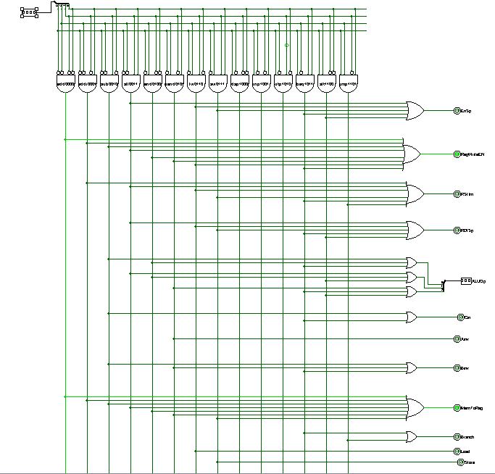
Control Unit :

Slide 13
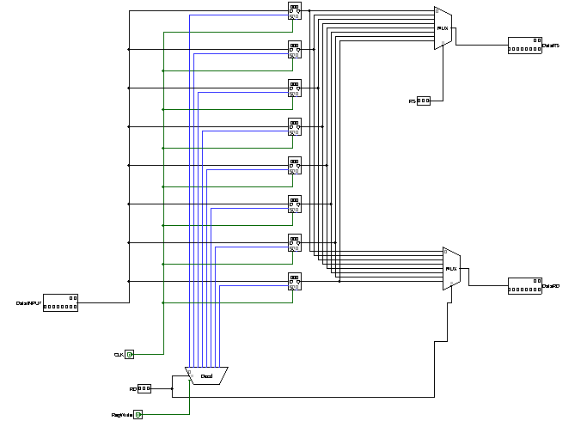
Register File :

Slide 14
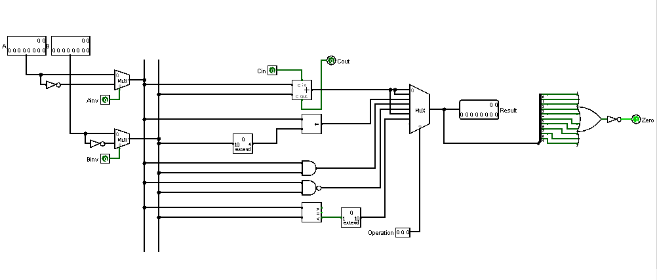
ALU :

Slide 15
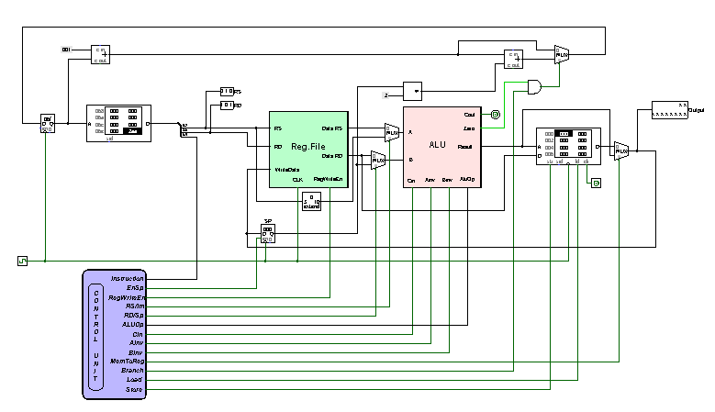
DataPath:

Slide 16
Advantage of our 10-Bit Processor :
1. Instruction cycle takes less time. it saves time in instruction fetching due to the absence of operand fetching due to the absence of operand fetch.
2. The accumulator is meant to be an operand. so there is no requirement for the operand address field for one operand in the instruction. this results in short of CPU supports zero address instructions. Normally CPUs have two types of instructions:
1)zero address
2)single address
the single address instruction have one operand in main memory and the other in accumulator.

Slide 17
Disadvantage of our 10-Bit Processor :
1.As we have only 10-bit that’s why we have to declare only 2 operands instead of 3 operands.
2. We have divided our 10-bit in 3 divisions. That’s why we couldn’t reserve space for shift amount. Thus we used the immediate 4-bit space in I type format for shifting purpose.

Slide 18
Thank You

